Slide 1
ENGINEERING GRAPHICS (Scales and Conic Section) MMMUT, Gorakhpur
Presented by- Neha Singh

Slide 2
Definition
A scale is defined as the ratio of the linear dimensions of the object as represented in a drawing to the actual dimensions of the same.

Slide 3
Necessity
Drawings drawn with the same size as the objects are called full sized drawing.
It is not convenient, always, to draw drawings of the object to its actual size. e.g. Buildings, Heavy
Hence scales are used to prepare drawing at
Full size
Reduced size
Enlarged size

Slide 4
BIS Recommended Scales
Reducing scales | 1:2 | 1:5 | 1:10
 | 1:20 | 1:50 | 1:100
1:Y (Y>1) | 1:200 | 1:500 | 1:1000
 | 1:2000 | 1:5000 | 1:10000
Enlarging scales | 50:1 | 20:1 | 10:1
X:1 (X>1) | 5:1 | 2:1
Full size scales |  |  | 1:1
Intermediate scales can be used in exceptional cases where recommended scales can not be applied for functional reasons.

Slide 5
Types of Scale
Engineers Scale :
The relation between the dimension on the drawing and the actual dimension of the object is mentioned numerically (like 10 mm = 15 m).
Graphical Scale:
Scale is drawn on the drawing itself. This takes care of the shrinkage of the engineer’s scale when the drawing becomes old.

Slide 6
Types of Graphical Scale
Plain Scale
Diagonal Scale
Vernier Scale

Slide 7
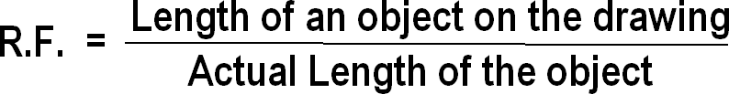
Representative fraction (R.F.)
When a 1 cm long line in a drawing represents 1 meter length of the object,
_{R.F =} 1cm ₌ 1cm ₌ 1 1m 1 x 100 cm 100

Slide 8
Plain scale
A plain scale consists of a line divided into suitable number of equal units. The first unit is subdivided into smaller parts.
The zero should be placed at the end of the 1st main unit.
From the zero mark, the units should be numbered to the right and the sub-divisions to the left.
The units and the subdivisions should be labeled clearly.
The R.F. should be mentioned below the scale.

Slide 9
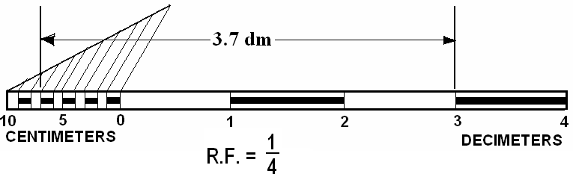
Construct a scale of1:4 to show centimeters and long
enough to measure up to 5 decimeters.
R.F. = ¼
Length of the scale = R.F. × max. length = ¼ × 5 dm = 12.5 cm.
Draw a line 12.5 cm long and divide it in to 5 equal divisions, each representing 1 dm.
Mark 0 at the end of the first division and 1, 2, 3 and 4 at the end
of each subsequent division to its right.
Divide the first division into 10 equal sub-divisions, each
representing 1 cm.
Mark cm to the left of 0 as shown.

Slide 10
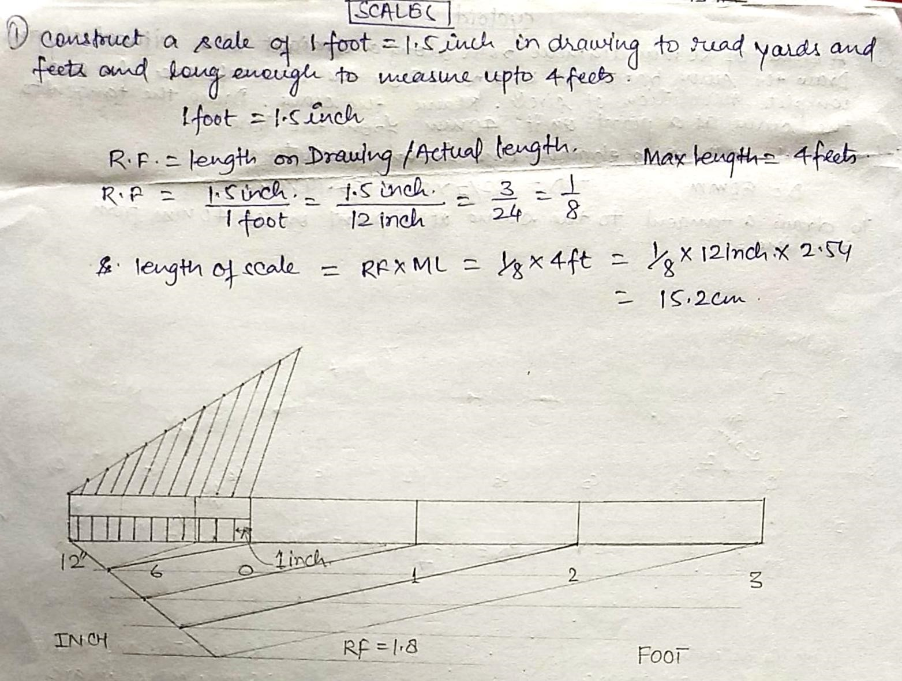
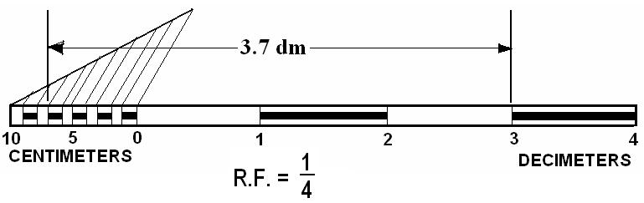
Question: Construct a scale of 1:4, to show centimeters and long enough to measure up to 5 decimeters
•
instead of only a line.
Draw the division lines showing decimeters throughout the width of the scale.
Draw thick and dark horizontal lines in the middle of all alternate divisions and sub-divisions.
Below the scale, print DECIMETERS on the right hand side, CENTIMERTERS on the left hand side, and R.F. in the middle.

Slide 11
Diagonal Scale
Through Diagonal scale, measurements can be up to second decimal (e.g. 4.35).
Diagonal scales are used to measure distances in a unit and its immediate two subdivisions; e.g. dm, cm & mm, or yard, foot & inch.
Diagonal scale can measure more accurately than the plain scale.

Slide 12
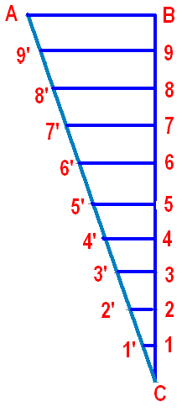
Diagonal scale…..Concept
At end B of line AB, draw a perpendicular.
Step-off ten equal divisions of any length along the perpendicular starting from B and ending at C.
Number the division points 9,8,7,…..1.
Through the points 1, 2, 3, etc., draw lines parallel to AB and cutting AC at 1´, 2´, 3´, etc.
Since the triangles are similar; 1´1 = 0.1 AB, 2´2 = 0.2AB, …. 9´9 = 0.9AB.
Gives divisions of a given short line AB in multiples of 1/10 its length, e.g. 0.1AB, 0.2AB, 0.3AB, etc.

Slide 13
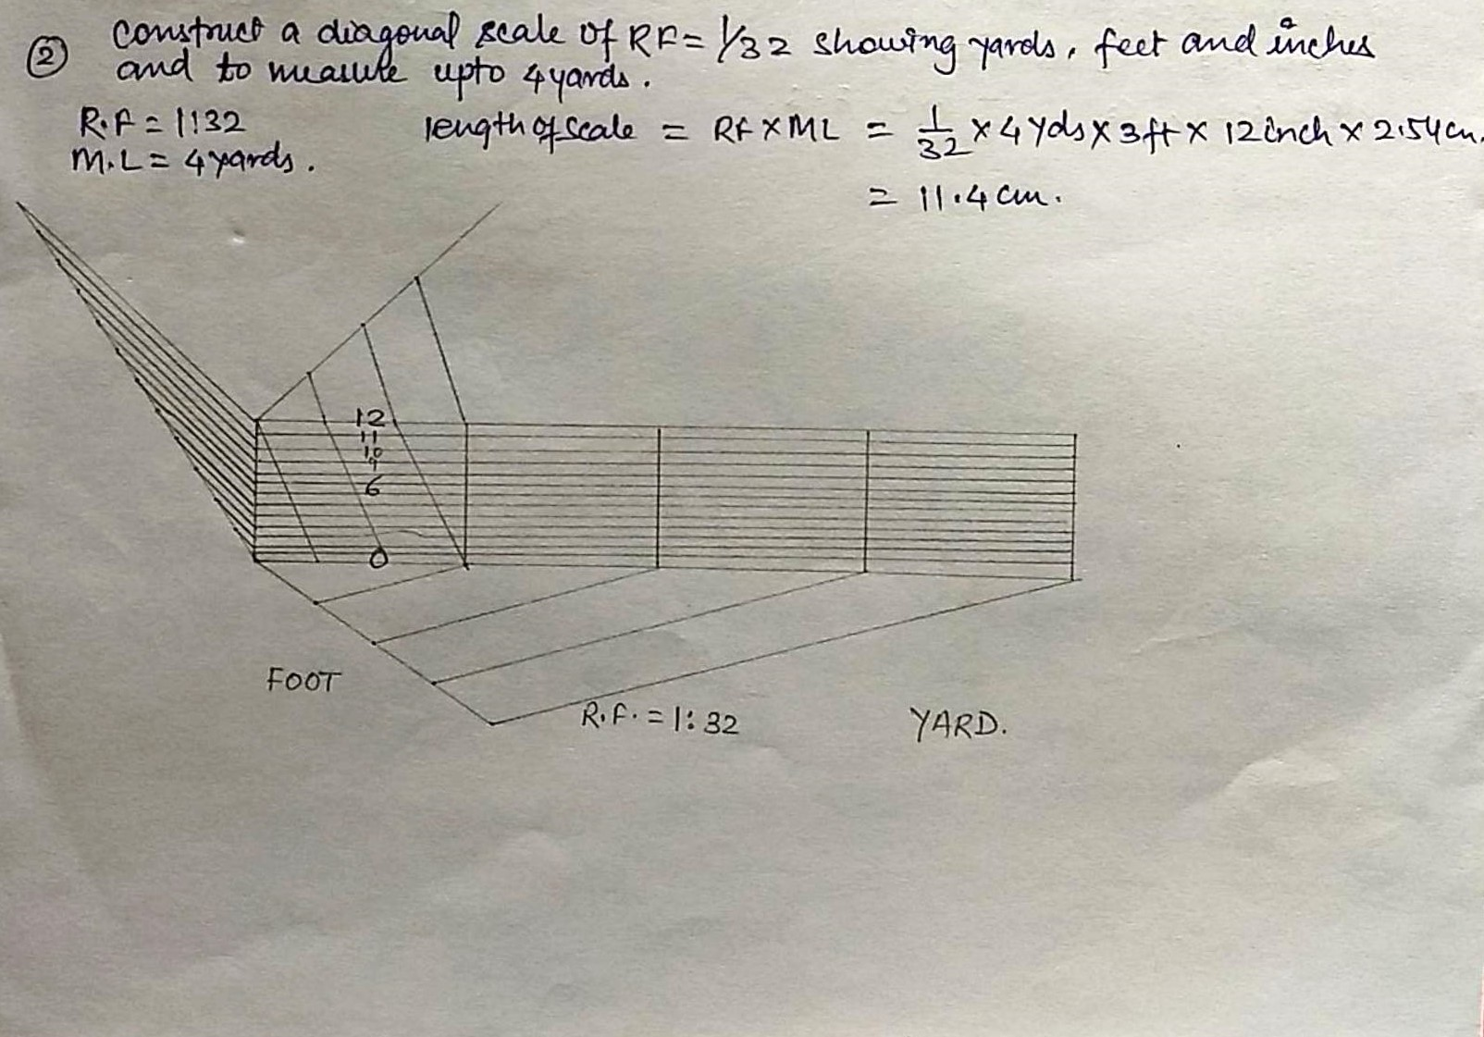
Diagonal Scale(problem)

Slide 14
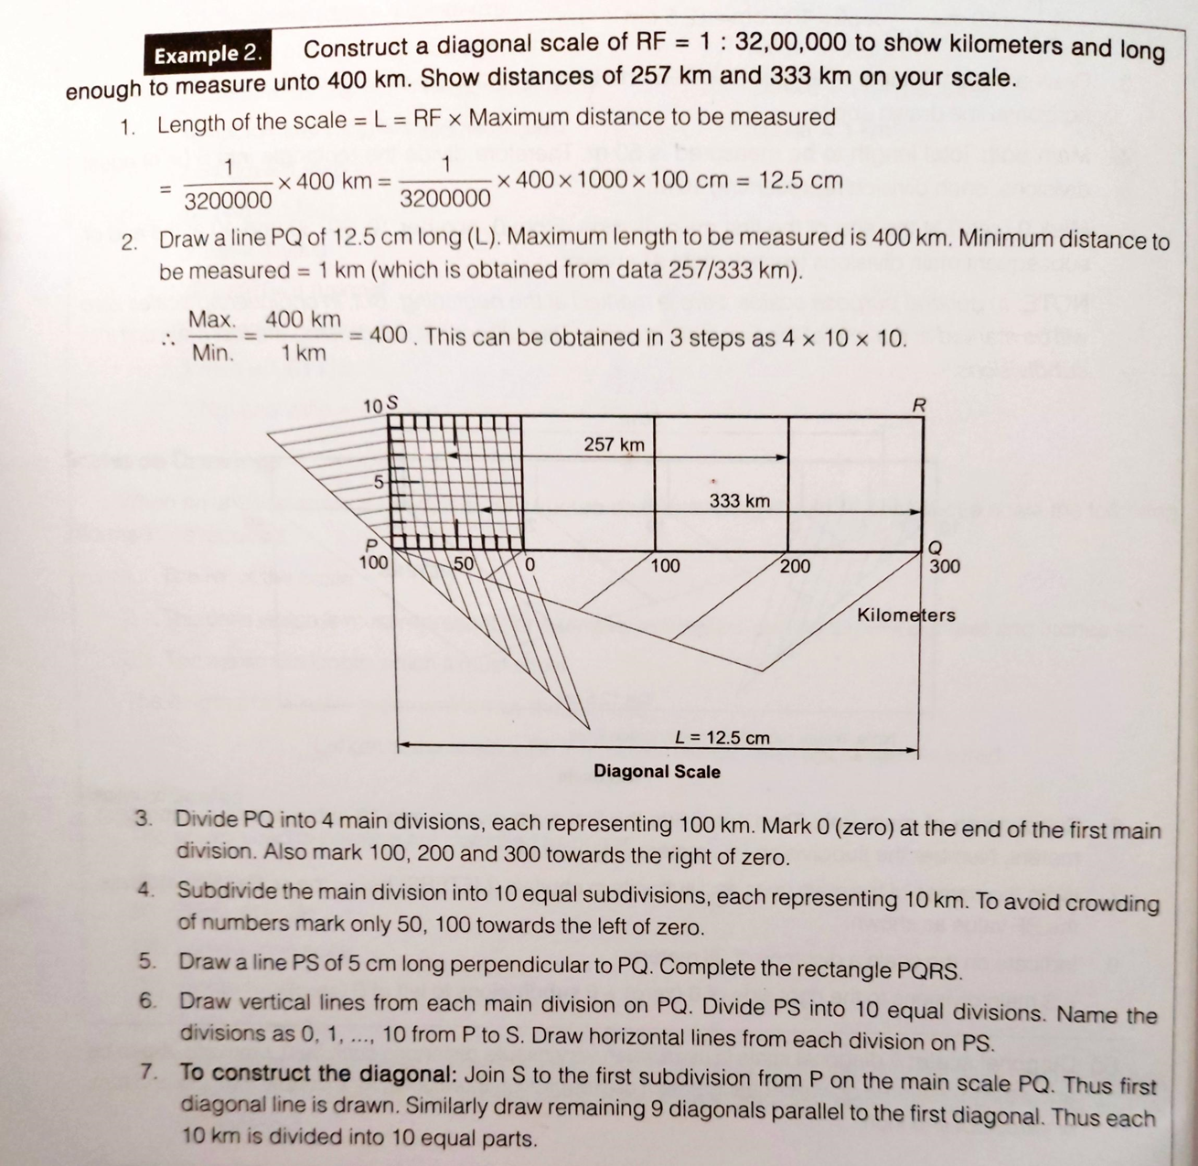

Slide 15
Vernier Scales
Similar to Diagonal scale, Vernier scale is used for measuring up to second decimal.
A Vernier scale consists of (i) a primary scale and (ii) a vernier.
The primary scale is a plain scale fully divided in to minor divisions.
The graduations on the vernier are derived from those on the primary scale.
Least count (LC) is the minimum distance that can be
measured.
Forward Vernier Scale :
MSD>VSD; LC = MSD-VSD
Backward Vernier scale:
VSD>MSD; LC = VSD - MSD

Slide 16
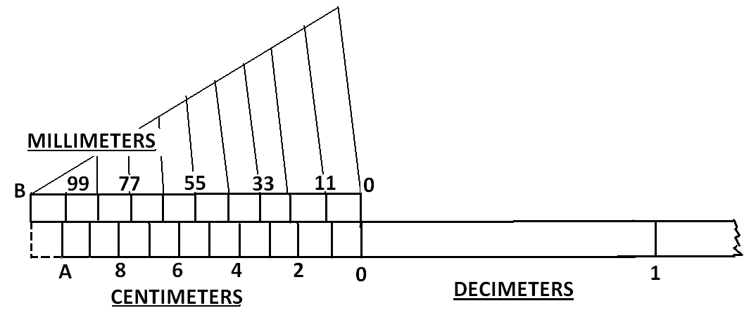
Vernier scale…. Concept
Length A0 represents 10 cm and is divided in to 10 equal parts each representing 1 cm.
B0 = 11 (i.e. 10+1) such equal parts = 11 cm.
Divide B0 into 10 equal divisions. Each division of B0 will be equal to 11/10 = 1.1 cm or 11 mm.
Difference between 1 part of A0 and one part of B0 = 1.1 cm -1.0 cm = 0.1cm or 1 mm.

Slide 17

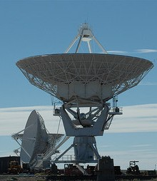

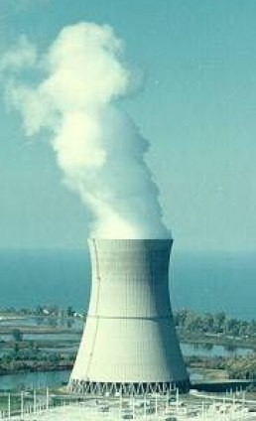
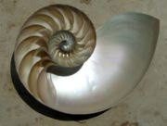
Common Engineering Curves
Parabolic shape
Elliptical shape
Hyperbola
spiral
20

Slide 18
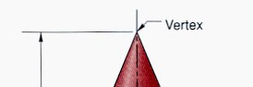
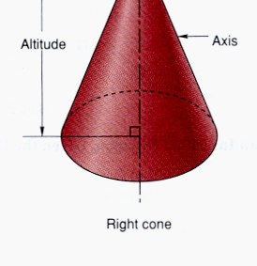

Conic curves (conics)
Curves formed by the intersection of a plane with a right circular cone. e.g. Parabola, hyperbola and ellipse
Right circular cone is a cone that has a circular base and the axis is inclined at 90⁰ to the base and passes through the center of the base.
21

Slide 19
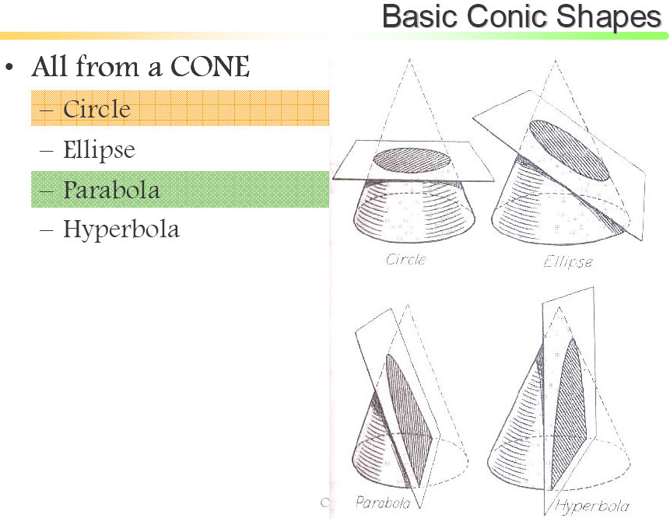
Conic sections are always "smooth". More precisely, they never contain any inflection points. This is important for many applications, such as aerodynamics, civil engg., mechanical engg, etc.
22

Slide 20
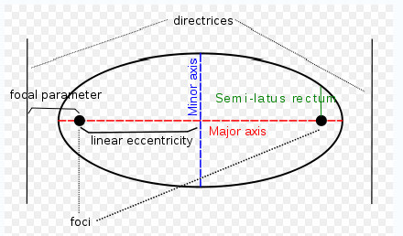
Conic
Conic is defined as the locus of a point moving in a plane such that the ratio of its distance from a fixed point and a fixed straight line is always constant.
Fixed point is called Focus Fixed line is called Directrix
23

Slide 21
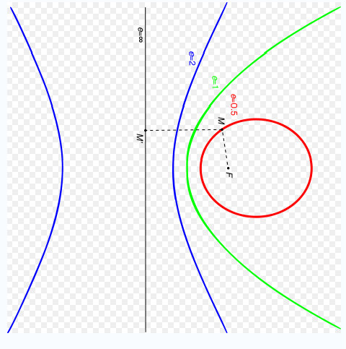
_{Eccentrici ty =} Distance of the point from the focus
Distance of the point from the directric
When eccentricity
< 1 € Ellipse
=1 | € | Parabola
> 1 | € | Hyperbola
eg. when e=1/2, the curve is an Ellipse, when e=1, it is a parabola and when e=2, it is a hyperbola.
24

Slide 22
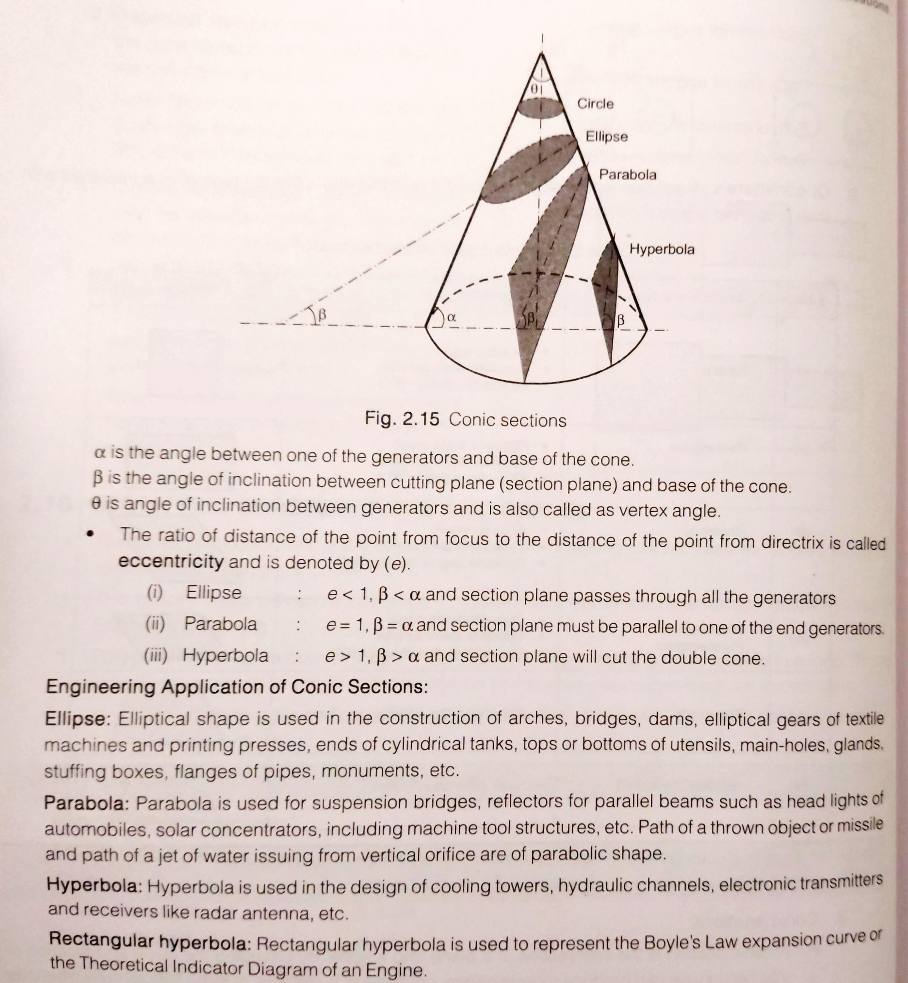

Slide 23
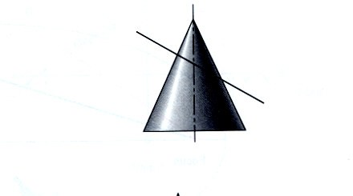
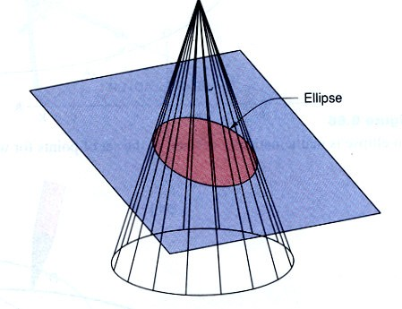
Ellipse
An ellipse is obtained when a section plane, inclined to the axis,
cuts all generators cone.
the
of the
25

